Slide 2
jenkins
Introduction
Type | Ci and cd tool
source | Open source
version | 2.73.2
vendor | Jenkins
Operation system | Cross plat from

Slide 3
DESCRIPTION
jenkins is an open source automation server written in Java.
Jenkins helps to automate the software development process, with continuous integration and continuous delivery.
It is a server-based system that runs in servlet containers such as Apache Tomcat.
The software enables developers to find and solve defects in a code base rapidly and to automate testing of their builds.
To run Jenkins the pre requitesed is java

Slide 4
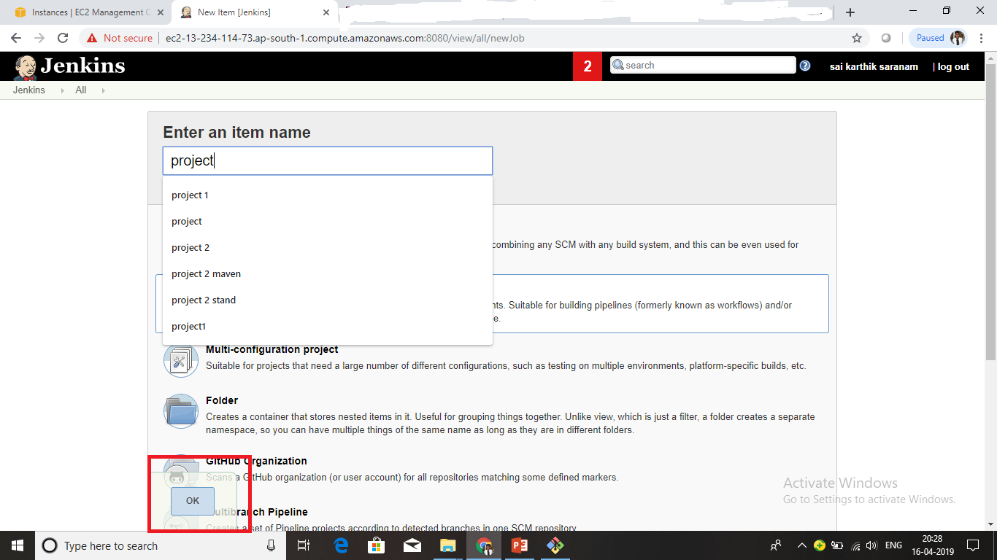
Who to create project
First we need to click on Jenkins dash board than we can see new item
than we can this tab

Slide 5
Create Master /slave
On you slave machine go to the Jenkins server url.
Go to Manage Jenkins > Manage Nodes, Click on the newly created slave machine.
Click on the Launch button to launch agent from browser on slave.
Run the program.

Slide 6
Web hooks
Go to your project repository.
Go to "settings" in the right corner.
Click on "web hooks."
Click "Add web hooks."
Write the Payload URL as.

Slide 7

Introduction
VENDOR | Linus Torvalds
TYPE | open source
DEVELOPED | 2005
VERSION | 2.13.5

Slide 8
DESCRIPTION
Git is a distributed version-control system for tracking changes in source code during software development. It is designed for coordinating work among programmers , but it can be used to track changes in any set of files.

Slide 9

Introduction
type | Scm tool
TYPE | open source , enterprise edition
DEVELOPED | 2008
VERSION | 2.16.5 (latest)

Slide 10
DESCRIPTION
GitHub is a web-based hosting service for version control using Git. It offers all of the distributed version control and source code management functionality of Git. GitHub is a scm repository.

Slide 11

Type | Java Based Build Tool
Vendor | Apache
Is Open Source? | Yes
Version | 3.5.2
Operating system | Cross Platform

Slide 12
DESCRIPTION
Apache Maven is a software project management and comprehension tool. Based on the concept of a project object model (POM), Maven can manage a project's build, reporting and documentation.
The most powerful feature is able to download the project dependency libraries automatically from maven central repo, maven remote repo or local repo.

Slide 13
Maven Repositories
A Maven repository can be one of the following types:
Local Repository
Central Repository
Remote Repository
Local Repository
The maven local repository is a local folder that is used to store all your project’s dependencies (plugin jars and other files which are downloaded by Maven). In simple, when you build a Maven project, all dependency files will be stored in your Maven local repository.
By default, Maven local repository is default to .m2 folder:
Unix/Mac OS X – ~/.m2 (/Users/BhaskarReddy/.m2/repository)
Windows – C:\Users\{your-username}\.m2
Maven Central Repository
The central repository is the repository provided by the Maven community. It contains a large repository of commonly used libraries. This repository comes into play when Maven does not find libraries in the local repository.
The central repository can be found at: http://search.maven.org/#browse.
Remote Repository
Enterprises usually maintain their own repositories for the libraries that are being used for the project. These differ from the local repository; a repository is maintained on a separate server, different from the developer's machine and is accessible within the organization.

Slide 14
Maven life cycles
Clean (life cycle and goal)
Site (life cycle and goal)
Default
In default we have different goals
validate
compile
test
package
install
deploy

Slide 15

wildfly

Slide 16
Introduction
type | Application server
vendor | Jboss,red hat
Is a open source | Yes it is free and open source
version | 16.0.0
Operating system | Cross plat from
WildFly, formerly known as JBoss AS, or simply Jboss
it is an application server authored by JBoss, now developed by Red Hat. Wildfly is written in Java and implements the Java Platform, Enterprise Edition (Java EE) specification. It runs on multiple platforms.

Slide 17
wildfly directory structure
Appclient
Bin
Docs
Domain
Modules
Standalone
Welcome-content
Appclient
Bin
Docs
Domain
Modules
Standalone
Welcome-content
To start wildfly go to bin folder and start wildfly by using this command
command sh standalone.sh –b 0.0.0.0 –bmanagement 0.0.0.0
To change the port number go to standalone ,configurations and open the standalone.xml file here we can do the changes

Slide 18
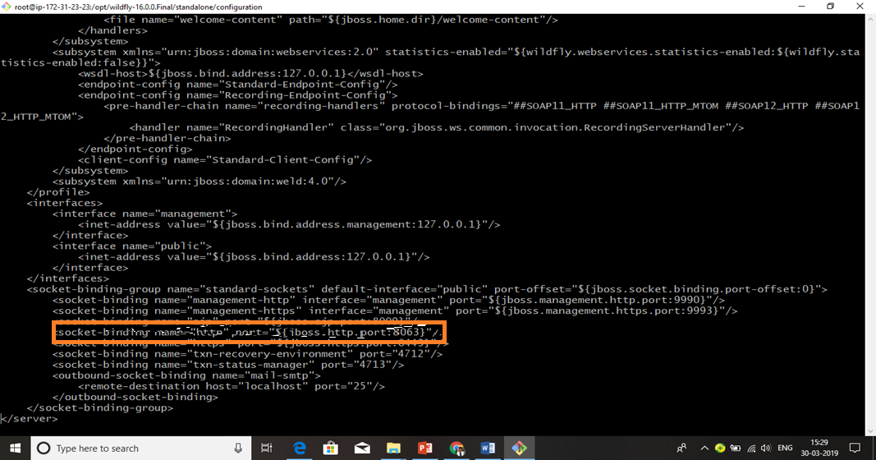

Slide 19


Slide 20
Introduction
type | Source continuous code quality
Vendor | SonarQube
Opensource | Yes
version | 7.x
Operating system | Cross platform
SonarQube (previously called Sonar) is an open source software
quality management tool.
It will continuously analyze
and measures quality of the source code.

Slide 21
How to execute the SonarQube report for antjavaprojects.Ans)create a file called sonar-project.properties file in the project root directory for which project need to execute the report with
Below
properties.sonar.projectName=MithunTechnologiessonar.projectKey=com.mtsonar.projectversion=1.0sonar.sources=src
How to execute the SonarQube report for maven java projects.Ans) mvn sonar:sonar
sonar.host.url=http://localhost:9000
To integrate sonar with Jenkins we need plugin sonar scanner

Slide 22

SONATYPE NEXUS
Introduction
Type | Artifactory repository
vendor | sonatype
Is it open source | yes
version | 3.x
Operation system | Crossplat form

Slide 23
DESCRIPTION
Nexus is a Artifactory repository manager allows to store and retrieve build artifacts. Nexus Repository Manager is available from Sonatype, Inc. "Sonatype" and "Sonatype Nexus" are trademarks of Sonatype, Inc.
Before Stating installation need to verify the below software should install.
Java : Verify with java -version command.
Maven: Verify with mvn -version
Installation:
Nexus Repository Manager can be downloaded from below URL.
https://www.sonatype.com/download-oss-sonatype

Slide 24
Start the Nexus repository server as follows. #cd NEXUS_HOME/bin #./nexus start (OR) ./nexus run (OR) ./nexus \run----> Mac/Linux
To insatall and run the nexus the prerequisite is java

Slide 25
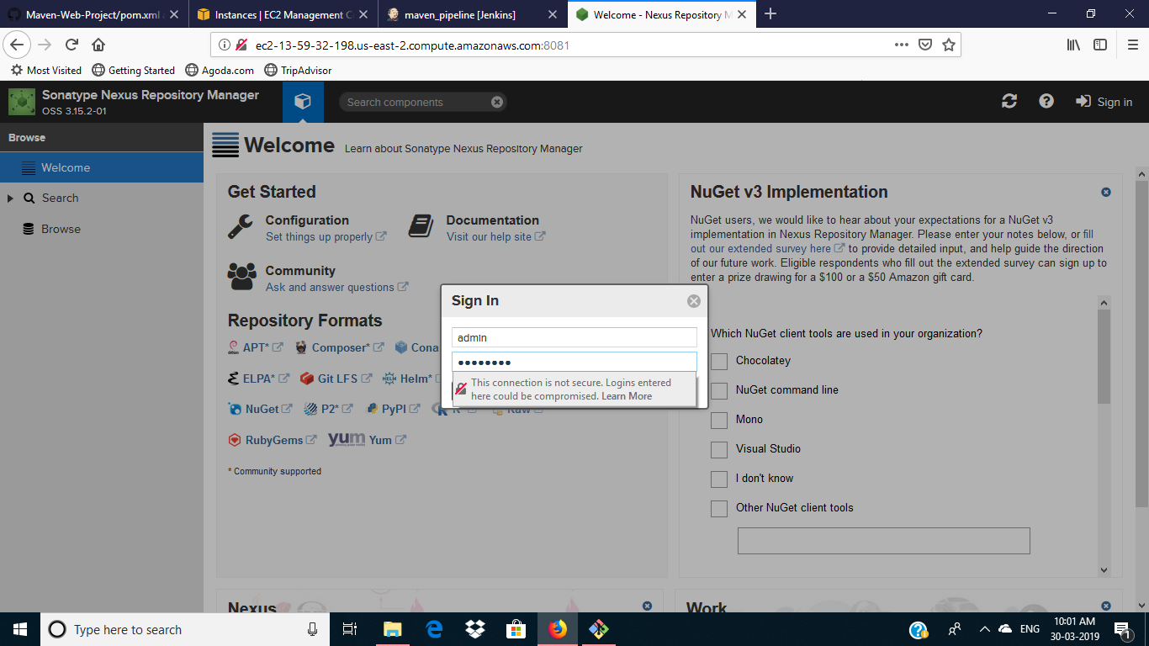
NEXUS URL: http://localhost:8081/---> 3.x Releases http://localhost:8081/nexus---> 2.x Releases The default credentials are admin/admin123

Slide 26
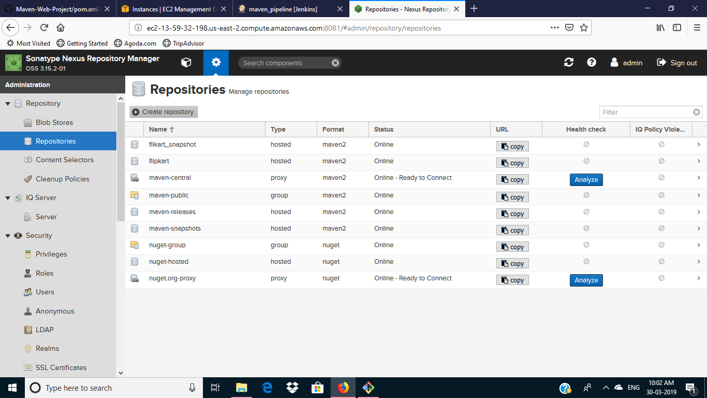
Login into Nexus repo with admin credentials and click on Administration Button and expand the Repository and click on Repositories and click on Create repository

Slide 27
In maven conf directory we can see settings.xml their we need to give nexus credentials
Nexus integration with Jenkins Add the below lines in
JENKINS_HOME/tool/Hudson_tasks.maven_MavenInstallation/maven_projects/conf
<servers>
<server>
<id>nexus</id>
<username>admin</username>
<password>****** </password>
</server>
</servers>
Note: Here replace **** with actual password
Update the pom.xml with below lines for each application

Slide 28
In pom.xml we need to give this tag to run the nexus report
<distributionManagement>
<repository>
<id>nexus</id>
<name> flipkart Releases Nexus Repository </name>
<url>http://localhost:8081/repository/flipkart releases</url>
</repository>
<snapshotRepository>
<id>nexus</id>
<name> flipkart Snapshot Nexus Repository </name>
<url>http://localhost:8081/repository/-snapshots</url>
</snapshotRepository>
</distributionManagement>

Slide 29
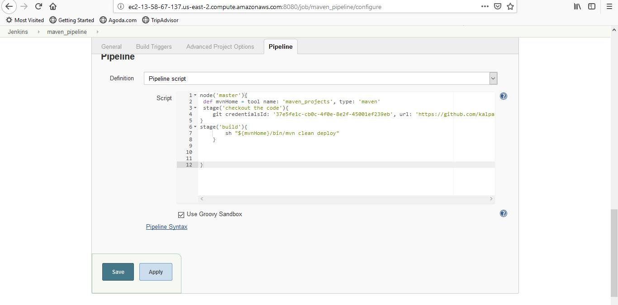
Add the below groovy script under pipeline project in Jenkins integration:

Slide 30
Any quaries

